Slide 1
ART
Graffiti and tagging

Slide 2
By: MELISSA and DARA

Slide 3
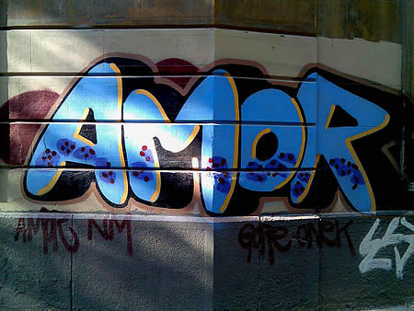
Tagging an graffiti
Some studies say that tagging is not an art form but the studies we have found show that it is.
Kids or taggers show who they are and what they are by tagging or graffiti

Slide 4
What’s the difference between tagging and graffiti
Graffiti is drawing on a public surface
Real graffiti involves a lot of work
Tagging is defined as a label
Taggers are most of time in gangs to mark their territories

Slide 5
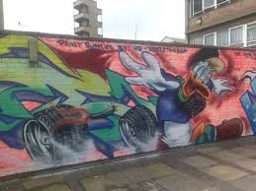
graffiti
Graffiti is an art form
It is show a lot on the walls of teenage room and in teenage drawing book
In the year 1971 graffiti came to life
There is no real inventor of the graffiti art we see today

Slide 6
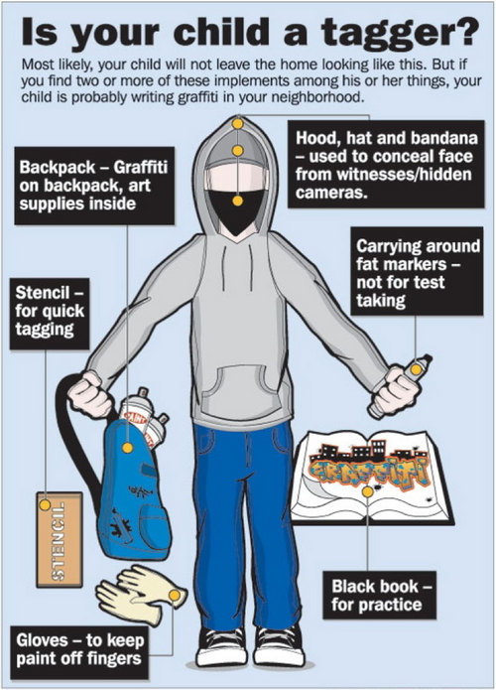
Tagging
Takes less time
Just one color to tag something

Slide 7
Pictures of tagging and graffiti

Slide 8
Tagging and graffiti pictures

Slide 9
Why is graffiti and tagging art?
Graffiti and tagging are art because the creator of the drawing said it is art
Also because it has color and emotion
It is there for a reason

Slide 10
What we think about graffiti and tagging
We think that some tags should not be there but some of the tags we found are the shit
Graffiti on the other hand is fun to look at. It has a lot of colors and comes out different every time.
We believe that tagging is art. It was put here for a reason

